Slide 1
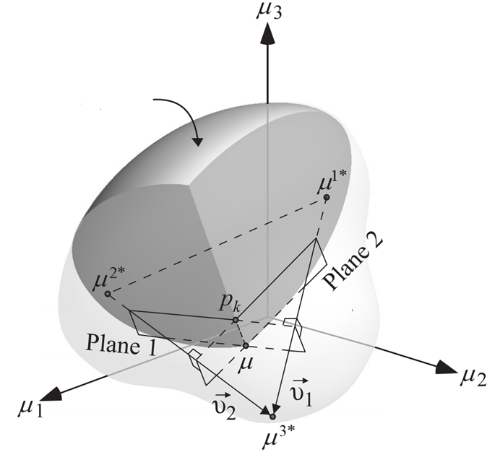
Reduced Feasible
Design Space
Utopia Plane
Feasible
Design Space

